Slide 1

Fundamentals of ML

Slide 2
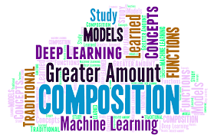
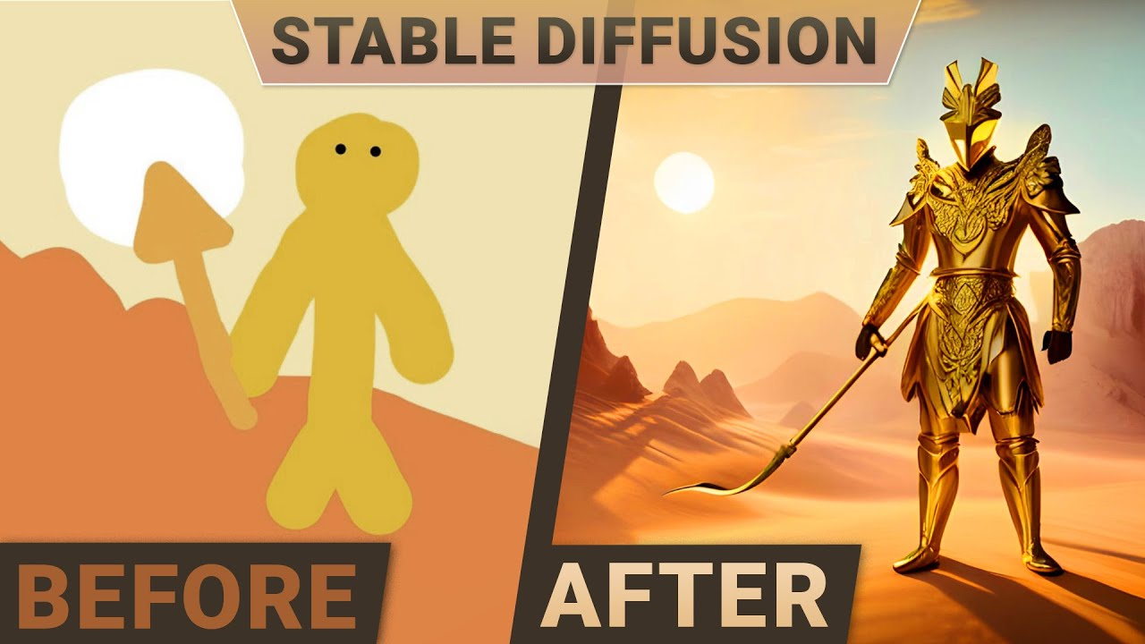
What is Machine Learning ?

Slide 3
Types of Machine Learning Algorithms
Supervised Learning
Unsupervised Learning
Machine Learning
Semi supervised Learning
Reinforcement Learning

